Slide 1
My Own Christmas Day
By Chiara Lubich

Slide 2
Christmas, feast of the birth of Jesus, is for me the reply of God and the Church to a need of the soul: to hear repeated to me every year through that commemoration of that fact so sweet, so sublime, so simple and so deep that God loves me.

Slide 3
Yes, if in my existence I am able to fulfill my deepest aspirations, it is only because God has looked upon me, as he has looked upon everyone, and has become man to give me the laws of life that, like a light along the road, help me to walk safely toward our common destiny.

Slide 4
But Christmas for me is not just a commemoration, however meaningful.
It spurs me on to work toward restoring the presence of Christ in the midst of the society in which I live.

Slide 5
He is there where two or more are united in his name
(Mt 18:20),

Slide 6
like an everyday spiritual Christmas

Slide 7
in homes,

Slide 8
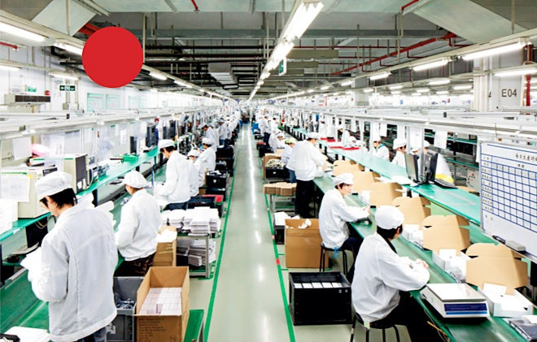
in factories,

Slide 9
in schools,

Slide 10
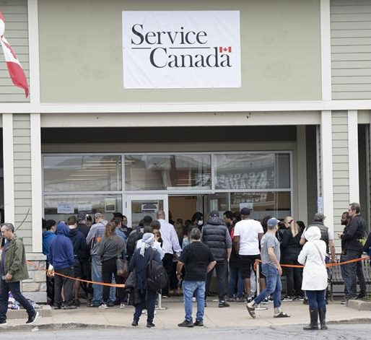
in public buildings…

Slide 11
This day of Christmas opens my heart to the whole of humanity.

Slide 12
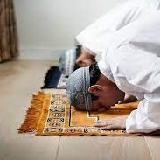
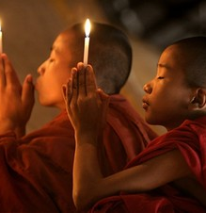
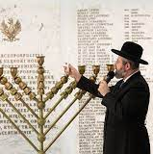
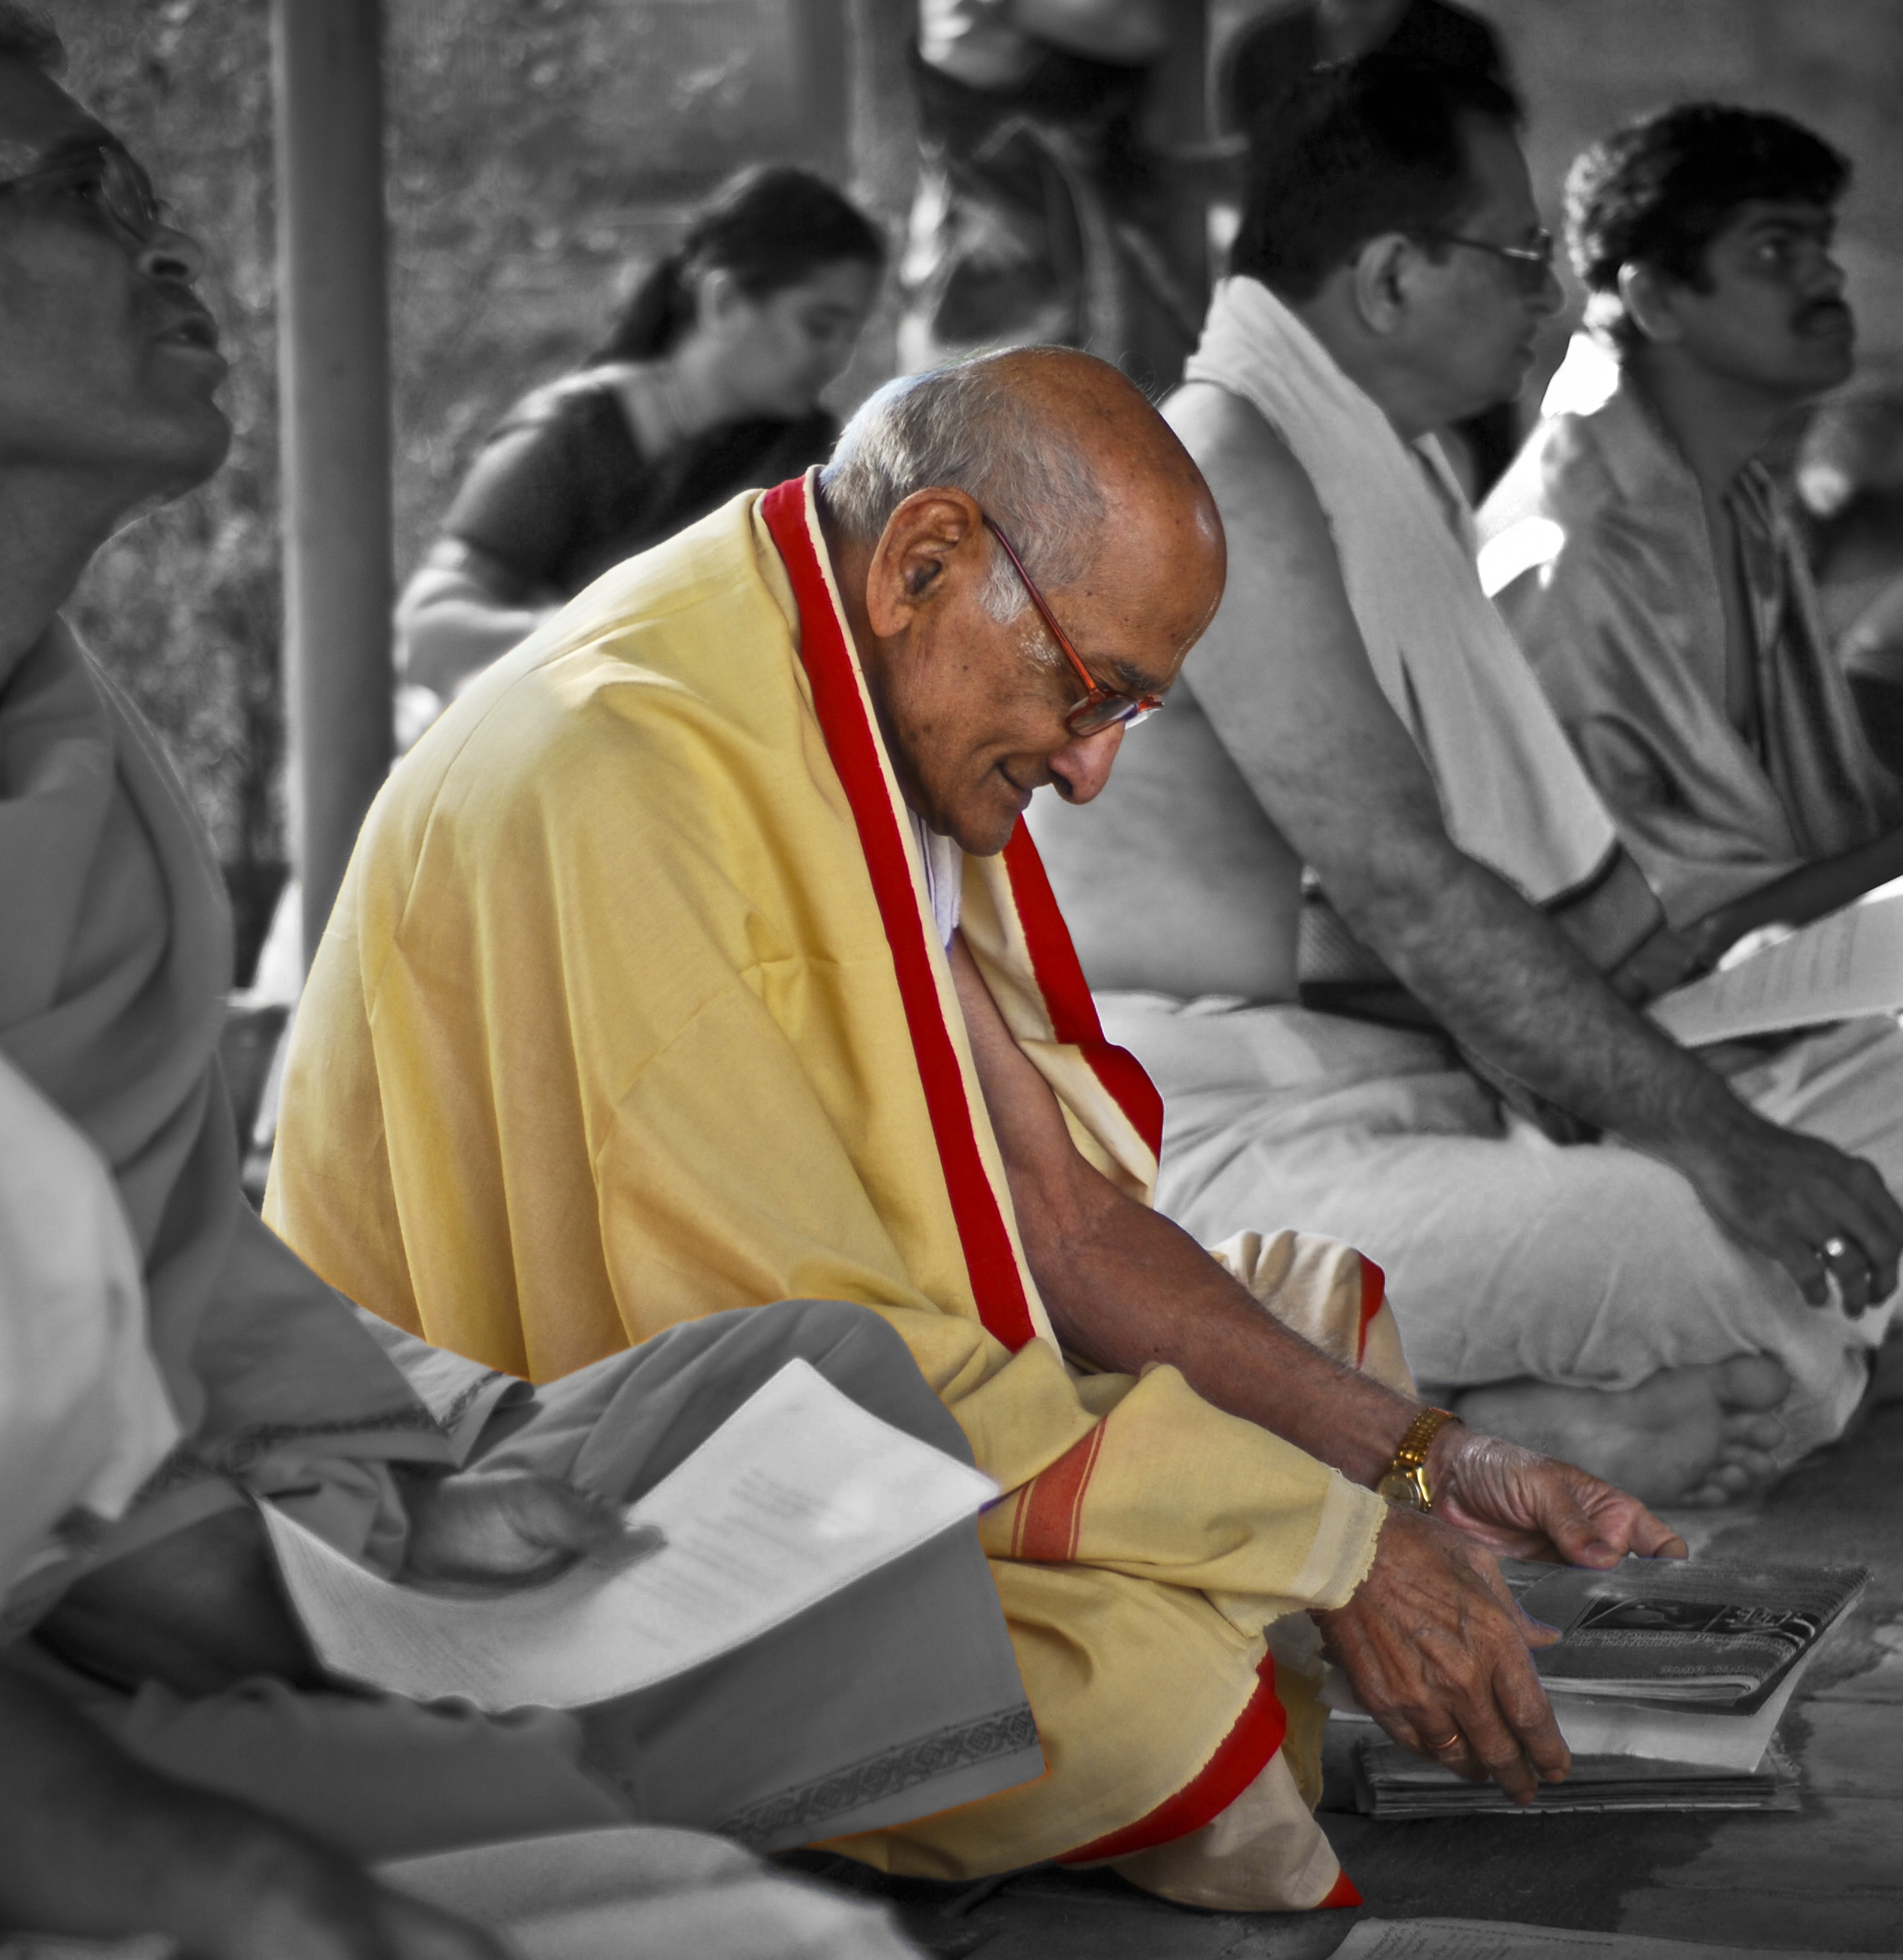
Its warmth goes beyond the Christian world and seems to invade every land, a sign that that child came for everyone.
In fact, it is his plan that all may be one (Jn 17:21).

Slide 13
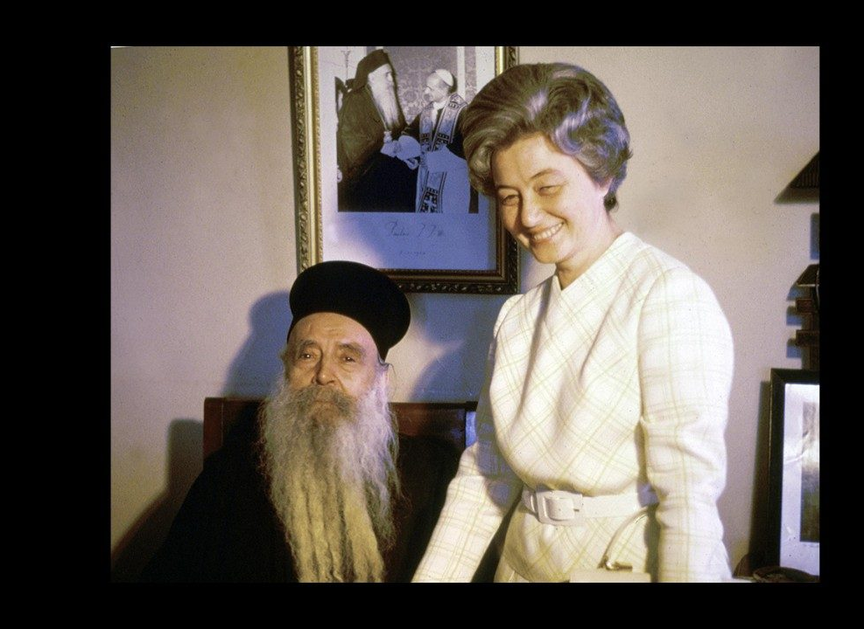
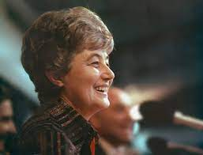
Every Christmas then, I always ask myself, “How many more Christmases will I see in my life?”

Slide 14
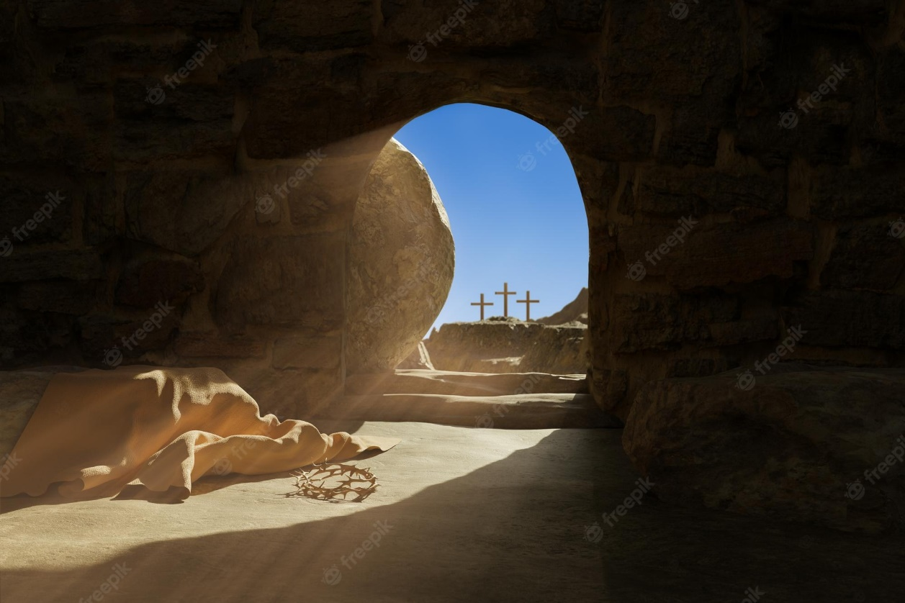
This question, which has no answer, helps me to live every year as if it were my last, with a greater awareness of that particular day that will signal for me the beginning of the life that never dies.

